Slide 1
GLOBAL SALES ANALYSIS
SYED SAAD
KOWSHIK CHOWDARY
CHEKITH SHANKARPALLY
MADHAN KISHORE
SREEJA ENABOTHULA

Slide 2
ABSTRACT
The Global Sales Analysis Project aims to design and implement a robust ETL (Extract, Transform, Load) pipeline for integrating and analyzing sales data from multiple countries using Google Cloud Platform (GCP) services. The project consolidates data from eight countries including India, Norway, Hong Kong, Oman, Germany, and Qatar each providing data in different formats such as CSV, JSON, Excel, and relational databases (MySQL, PostgreSQL, SQL Server).The ETL process involves data ingestion into Google Cloud Storage (GCS), processing and transformation using Airflow, and loading into BigQuery for centralized storage and analysis. Key transformations include currency conversion to INR, null handling, and data standardization. The processed data is then visualized through Looker Studio, providing interactive dashboards and detailed reports for stakeholders.

Slide 3
Technologies USED
Cloud Storage (GCS) used to store and manage file-based data (CSV, Excel, JSON).
Cloud SQL used to manage relational databases (MySQL, SQL Server) for India, Oman, Germany, Qatar.
AlloyDB used to host PostgreSQL database for Norway.
Cloud Composer (Airflow) used to orchestrate and schedule ETL workflows.
BigQuery used to central data warehouse for cleaned, unified, and transformed sales data.
BigQuery ML used to forecast next month’s sales using built-in ML models.
Looker Studio used to build interactive dashboards and visualizations for stakeholders.

Slide 4
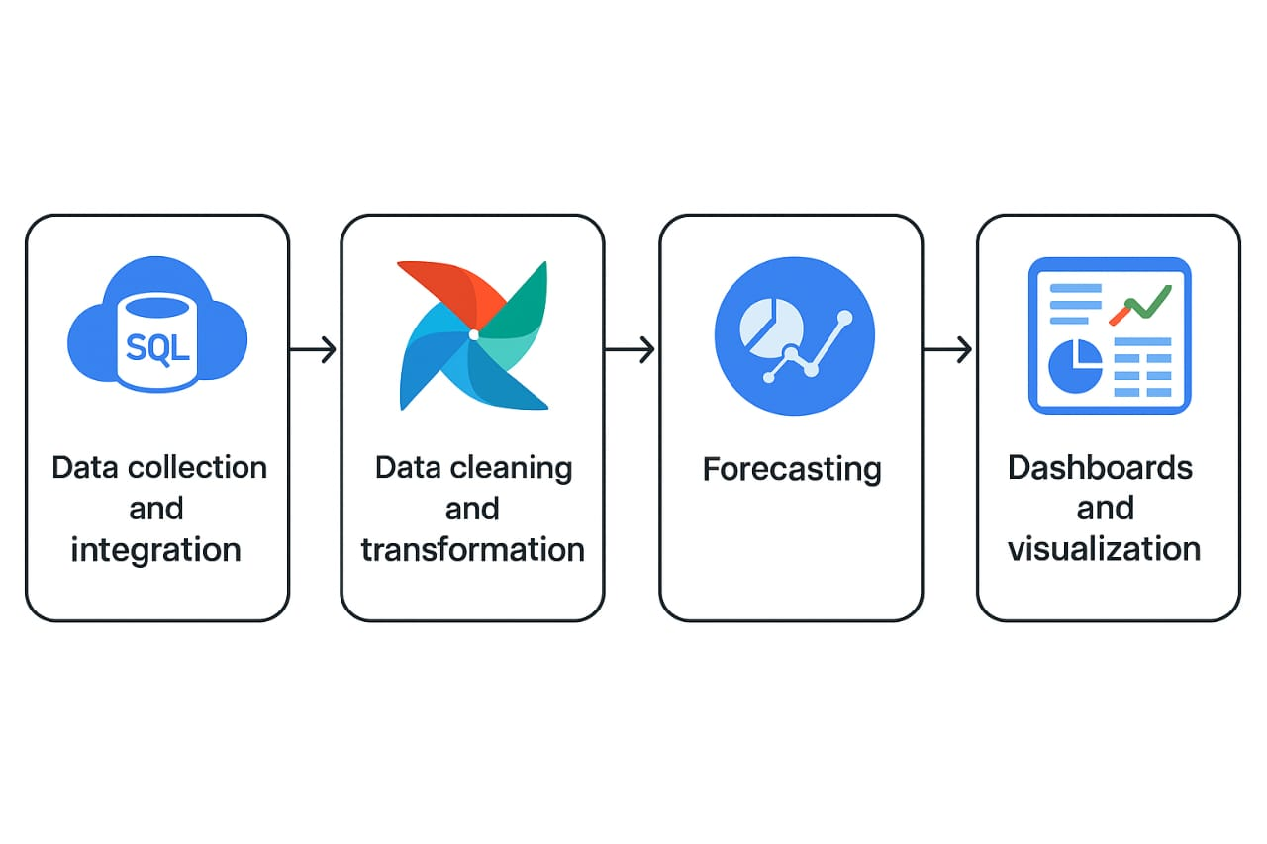
workflow

Slide 5
Process of development
DATA COLLECTION
DATA INGESTION
Collected raw sales data and created 200 records for each 8 countries in various formats such are,
India (SQL Server)
Japan (CSV)
Sri Lanka (JSON)
Hong Kong (Excel)
Norway (PostgreSQL) and
Germany, Qatar, Oman (MySQL).
Ingest and centralize raw sales data from multiple countries into Google Cloud Storage and connects to databases using Cloud SQL for ETL processing.
.Connecting databases using Cloud SQL connectors and federation like SQL server, AlloyDB, MySQL .We have to create the clusters for different countries and connect the databases then import the data from the bucket.
Automated ingestion using Cloud Composer (Airflow) DAGs.

Slide 6
Process of development
DATA CLEANING
Inspect ingested data for nulls, missing values, and inconsistencies.
Remove duplicates and handle encoding issues. Fix date formatting problems across datasets.
Normalize column names and data types across all country datasets. Validate cleaned data by comparing with source data.
Communicate regularly with the ingestion team to ensure smooth data flow. Ensure all cleaning scripts are modular and reusable.
Document cleaning steps and processes. Handle error logging and report data quality issues.
Prepare cleaned datasets for the transformation stage.

Slide 7
Process of development
DATA TRANSFORMATION
Design transformation logic to standardize datasets from all countries. Apply currency conversion for all sales values into INR using a predefined table.
Merge cleaned datasets into a unified structure before loading into BigQuery. Develop Airflow DAGs for data transformation workflows. Automate scheduling and execution of transformation pipelines
Validate transformed data accuracy and completeness.
Coordinate with the forecasting team to provide clean, transformed data.
Ensure transformation code is optimized for performance and scalability.
Document transformation processes and pipeline workflows. Troubleshoot and fix any transformation pipeline errors.

Slide 8
Process of development
FORECASTING
The process of using historical data to make informed predictions about future outcomes we use BigQuery ML to build and train time series models directly in BigQuery using SQL. we're forecasting future sales volume and revenue using past transaction data.
We used a Linear Regression model in BigQuery ML to predict sales values based on features such as quantity, product category, product name, and country. This approach helps us understand how these variables influence sales and enables prediction of sales for new or incomplete records.

Slide 9
PROCESS OF DEVELOPMENT
DATA VISUALISATION
Looker Studio is used to build interactive, real-time dashboards and visualizations for various stakeholders. It connects directly to BigQuery, where your cleaned and transformed sales data is stored.
We have to create dashboards for product-wise, country-wise sales, tax calculations, and forecasting data.

Slide 10
OUTPUTs
Product-Wise Sales Summary for Stakeholder Analysis
To enable effective decision-making, a stakeholder requested a report summarizing the total quantity sold for each product, along with other essential details like product name, category, unit price, and total sales amount.
We generated a Google Cloud Storage link to a structured .csv file containing the following columns:
ProductID (PId)
ProductName (Pname)
Category (PCategory)
QuantitySold (QtySold)
UnitPrice (Price)
TotalAmount (QtySold × Price)
https://storage.googleapis.com/srilanka-p2/bquxjob_4b5a17c6_196f920182d.csv
This file allows the stakeholder to independently analyze, filter, or visualize product performance across countries using Excel or Google Sheets.

Slide 11
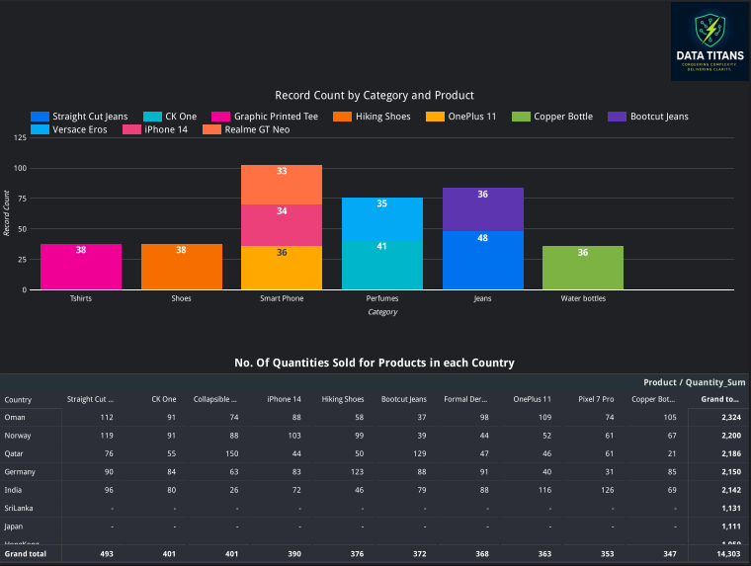
B. Visual Sales Analytics by Category & Country for Stakeholder

Slide 12
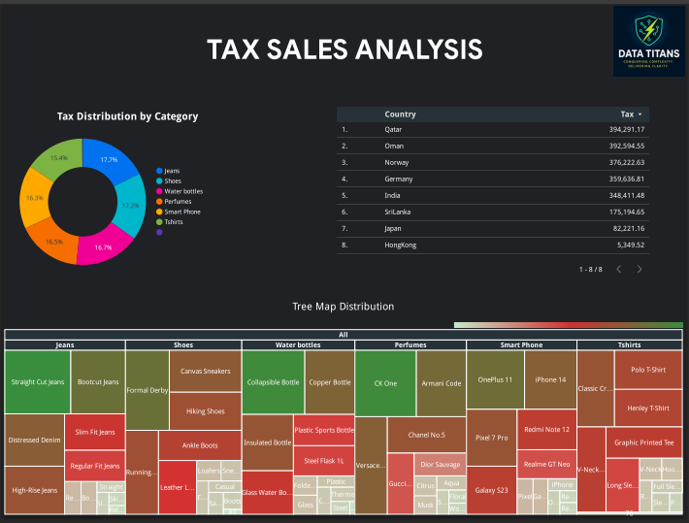
C. Tax Department Reporting

Slide 13
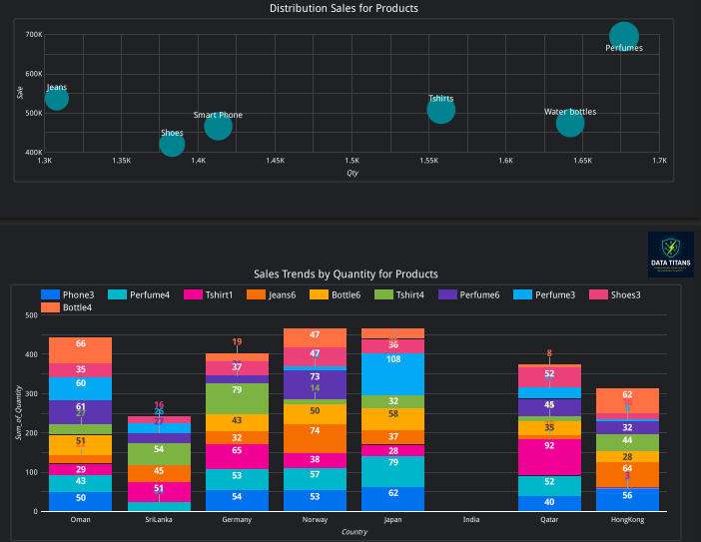
D. SALES ANALYSIS FOR OUR TEAM TO UNDERSTAND INSIGHTS

Slide 14
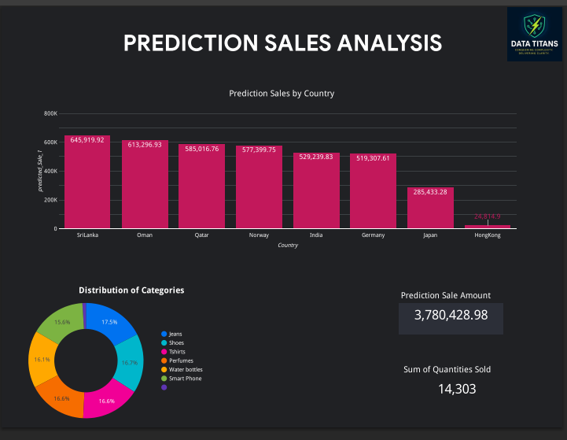
e. Unified Design & Branding in Dashboards

Slide 15
FUTURE PLANS & ENHANCEMENTS
ENHANCEMENTS
Real-Time ETL using Pub/Sub and Dataflow for live ingestion.
Language Translation using Cloud Translate API for non-English inputs
Product Recommendation System using advanced ML models.
User Role Dashboards with customized views (admin, sales, finance).
Automated Email Reports using Cloud Functions + Gmail API.

Slide 16
Thank You
CHEKITH-shankarpallychekith@gmail.com
KOWSHIK-saikowshikmullaputi@gmail.com
SYED SAAD-s.saadbme@gmail.com
SREEJA-sreejaenabothula@gmail.com
MADHAN KISHORE-madhankishorebotlapati123@gmail.com

